Slide 1
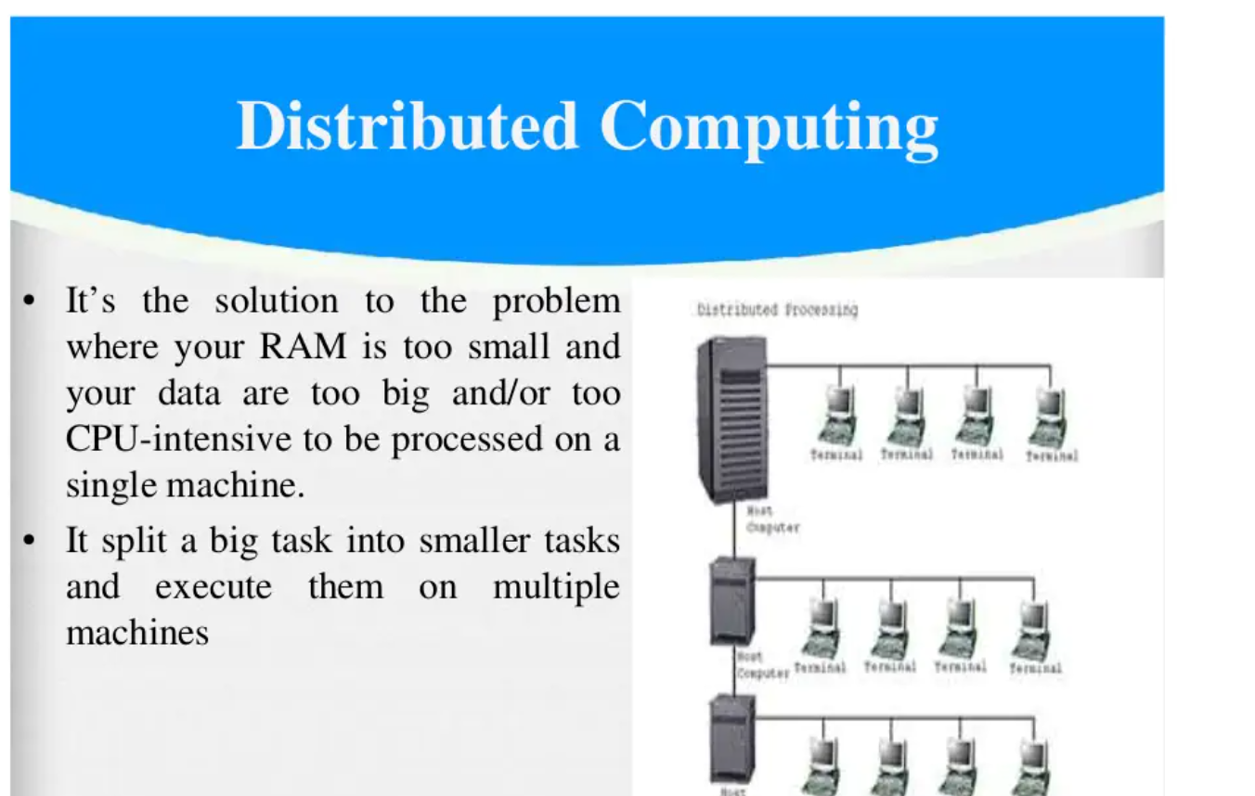

Slide 2
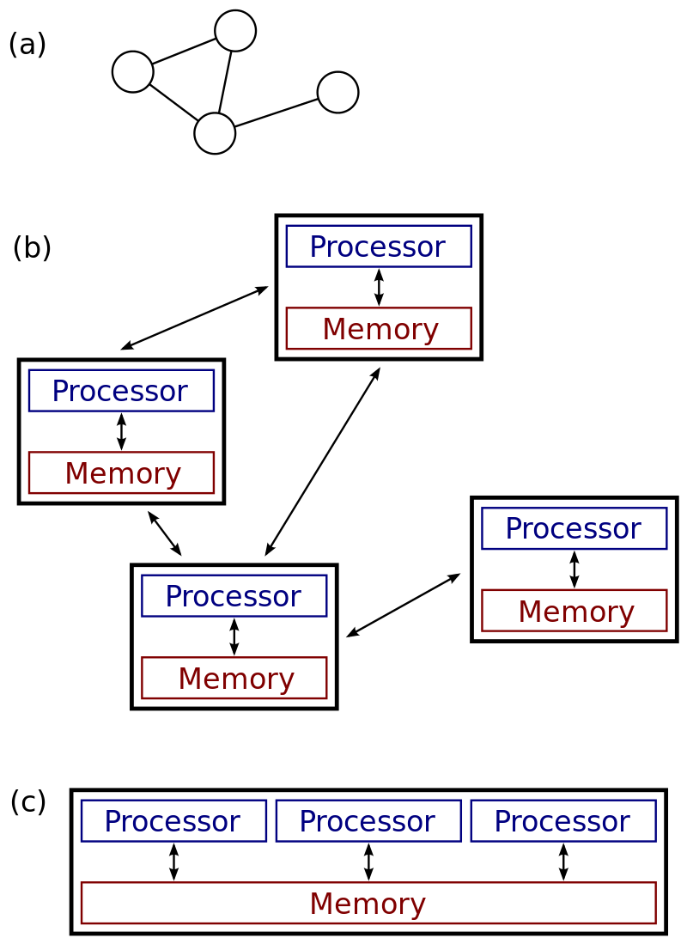
(a), (b): a distributed system. (c): a parallel system.

Slide 3
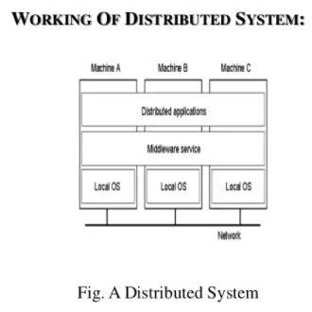

Slide 4
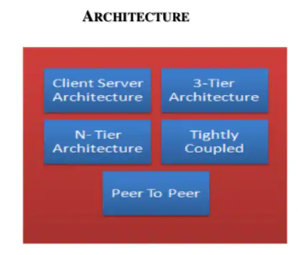

Slide 5
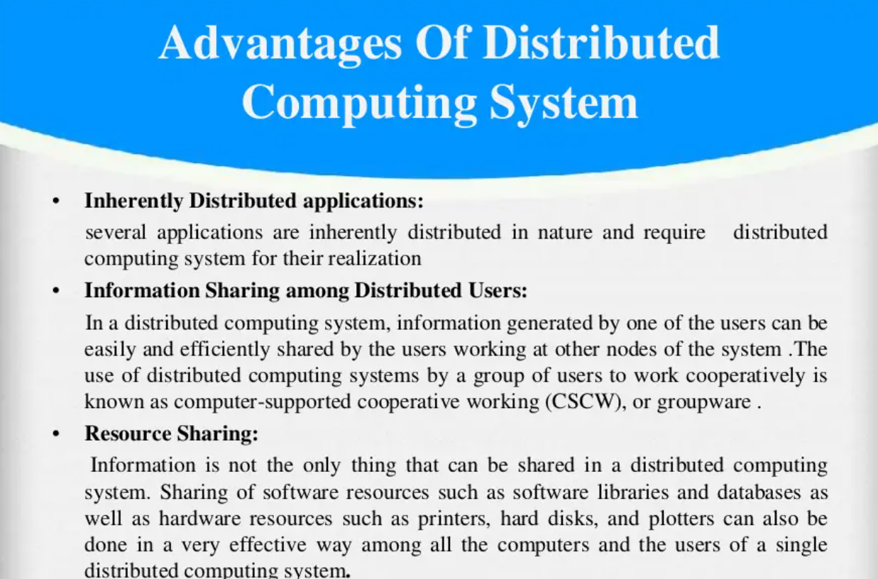

Slide 6
Ways of Distributed Systems
Distributed Computing System :The distributed system is used in performance computation which requires high computing.
Cluster Computing: Cluster Computing is a collection of connected computers that work together as a unit to perform operations together, functioning in a single system.
Clusters are generally connected quickly via local area networks & each node is running the same operating system.

Slide 7
Cluster Continued…
When input comes from a client to the main computer, the master CPU divides the task into simple jobs and sends it to the slave note to do it when the jobs are done by the slave nodes, they send it back to the master node, and then it shows the result to the main computer.

Slide 8
Advantages of Cluster Computing Disadvantages of Cluster Computing
High Performance High cost.
Easy to manage The problem is finding the fault.
Scalable More space is needed.
Expandability The increased infrastructure is needed.
Availability
Flexibility
Cost-effectiveness
Distributed applications

Slide 9
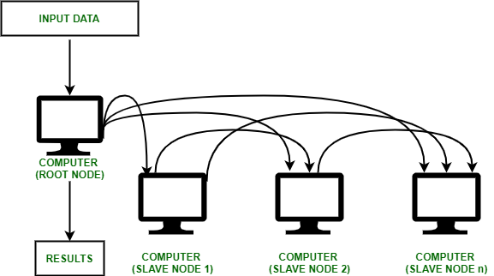

Slide 10
Types of Cluster computing
High performance (HP) clusters
solve advance computational problems,
parallel processing
2. Load-balancing clusters
3. High Availability (HA) Clusters
Classification of Cluster
Open Cluster
Close Cluster

Slide 11
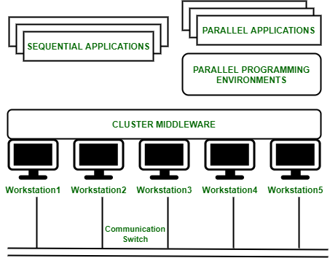
Cluster Computing Architecture
Components of a Cluster Computer :
Cluster Nodes
Cluster Operating System
The switch or node interconnect
Network switching hardware

Slide 12
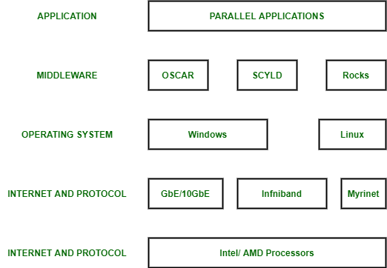
Cluster Components

Slide 13
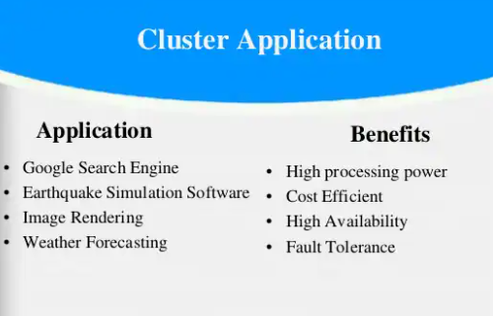

Slide 14
Grid Computing: In grid computing, the subgroup consists of distributed systems, which are often set up as a network of computer systems, each system can belong to a different administrative domain and can differ greatly in terms of hardware, software, and implementation network technology.
The different department has different computer with different OS to make the control node present which helps different computer with different OS to communicate with each other and transfer messages to work.

Slide 15
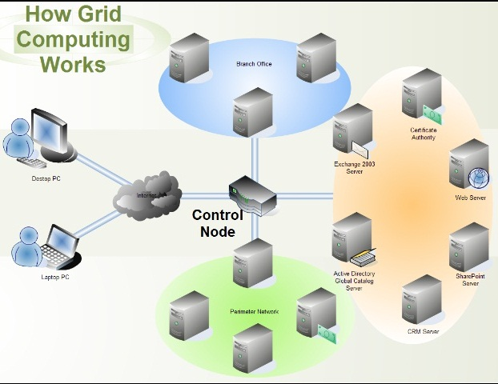

Slide 16
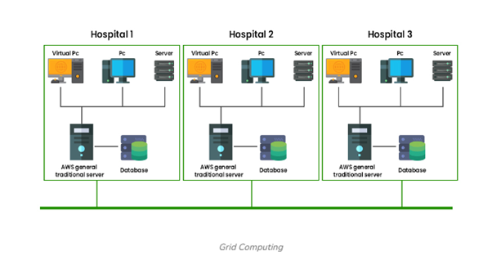
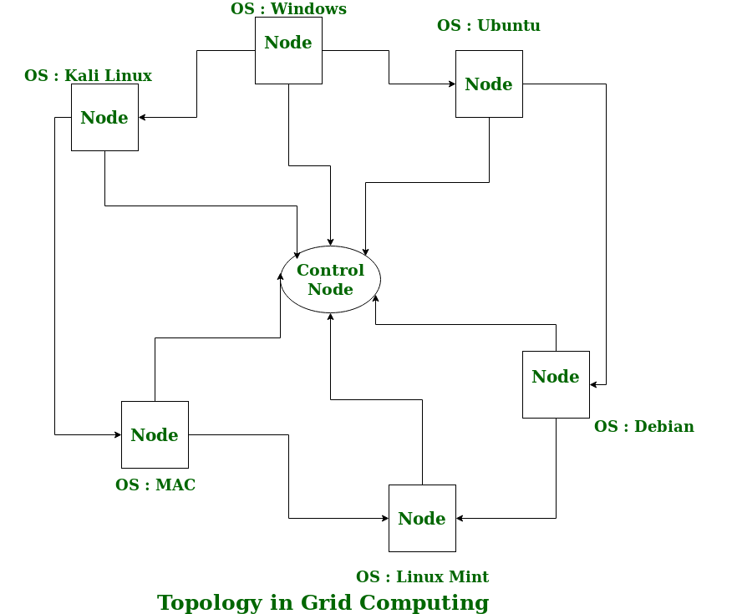
Grid Continued…

Slide 17
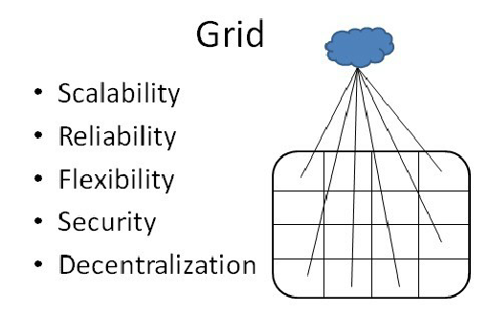

Slide 18
Grid Advantages
Offers a cost effective solution & ability to use many resources.
Saves money & resources by utilising the power of idle computers.
Can solve bigger and more complex problems in a shorter time frame. Easier collaboration with other organizations and better use of existing equipment.
Disadvantages of Grid Computing
Non-interactive job submission.
Licensing on many servers can be prohibitive for some applications.
You may need a fast connection between computer resources.

Slide 19
Distributed Information System
Distributed transaction processing: It works across different servers using multiple communication models. The four characteristics that transactions have:
Atomic: The transaction taking place must be indivisible to the others.
Consistent: The transaction should be consistent after the transaction has been done.
Isolated: A transaction must not interfere with another transaction.
Durable: Once an engaged transaction, the changes are permanent. Transactions are often constructed as several sub-transactions, jointly forming a nested transaction.
Each database can perform its query containing data retrieval from two different databases to give one single result

Slide 20
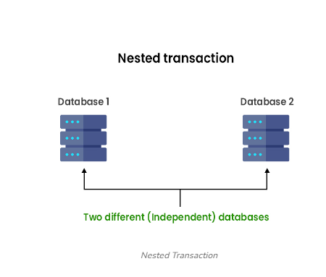
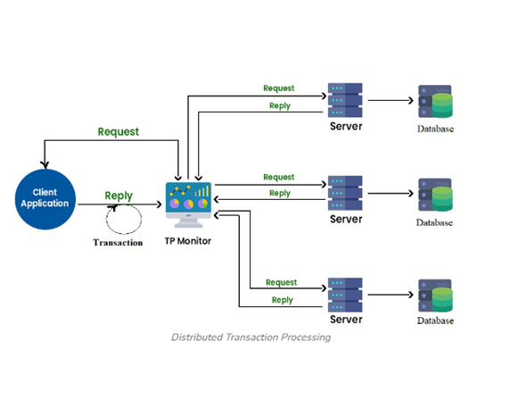

Slide 21
In the company’s middleware systems, the component that manages distributed (or nested) transactions has formed the application integration core at the server or database. This was referred to as the Transaction Processing Monitor(TP Monitor).
Its main task is to allow an application to access multiple servers/databases by providing a transactional programming model.
Many requests are sent to the database to get the result, to ensure each request gets successfully executed and deliver result to each request, this work is handled by the TP Monitor.

Slide 22
Utility Computing
Utility computing is defined as a service provisioning model that offers computing resources to clients as and when they require them on an on-demand basis. The charges are exactly as per the consumption of the services provided, rather than a fixed charge or a flat rate.
The term utility is the utility services like water, telephone, electricity, and gas that are provided by any utility company. Similarly, the customer when receives utility computing, its computing power on the shared computer network bills is decided based on the consumption which is measured.
Utility computing is similar to virtualization and the total web storage space amount with the computing power that is made available to the user is higher as compared to a single time-sharing computer. The web service is possible through several backend web servers. The web servers could be dedicated and used as a cluster form which is created and then gets leased to the end-user. Distributed computing is the method where a single such calculation is done on multiple web servers.

Slide 23
Grid & Utility
Grid Computing | Utility Computing
It is a process architecture which combines different computing resources from multiple locations to achieve desired and common goal | It is a process architecture that provide on-demand computing resources and infrastructure on basis of pay per use method
It distributes workload across multiple systems and allow computers to contribute their individual resources to common goal | It allows organization to allocate & segregate computing resources & infrastructure to various users as per their requirement
It mainly concentrates on sharing of the resources | It mainly concentrates on acquiring computing resources
It is of three main types computation grid, data grid and collaborative grid | It is of two types external & internal utility
It is used in ATMs ,backend infrastructure, marketing research etc | It is used in large organizations such as Amazon,Google etc. where they establish their own utility services for computing storage & apllications.

Slide 24
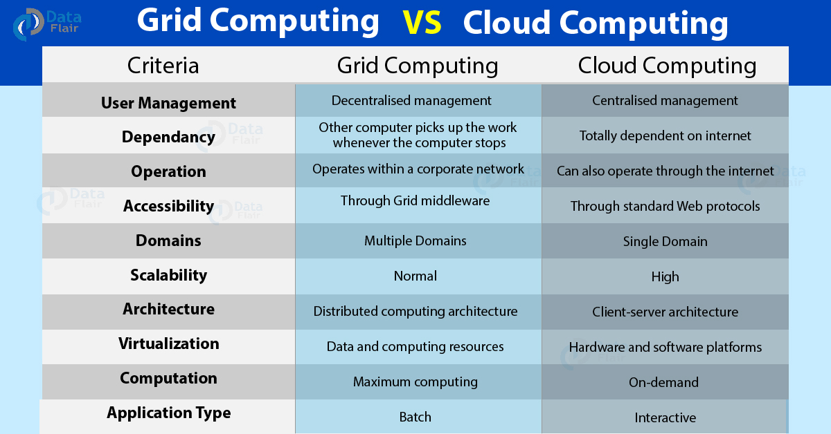

Slide 25
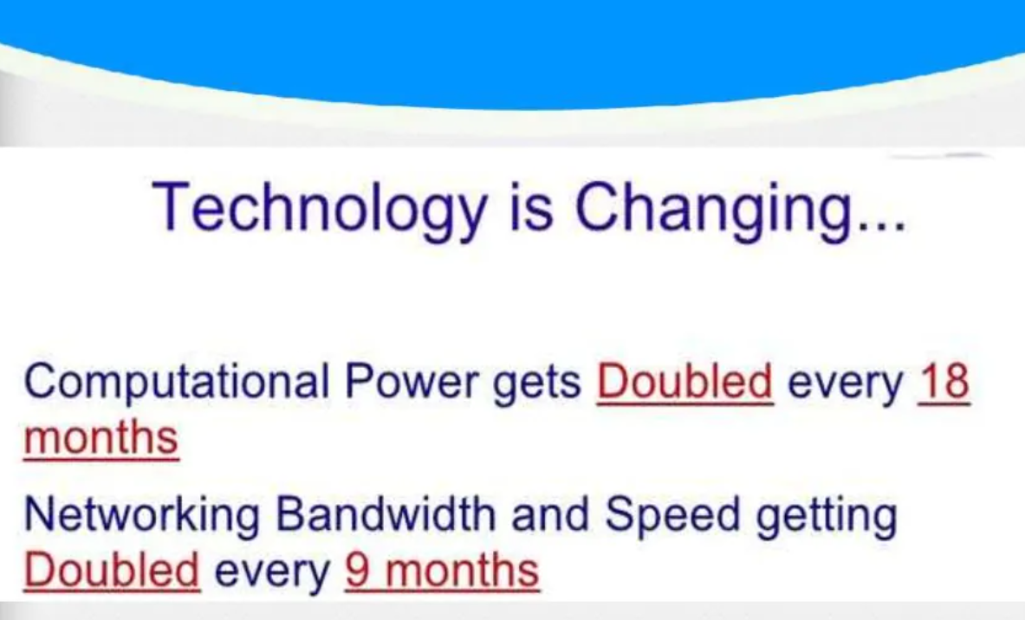

Slide 26
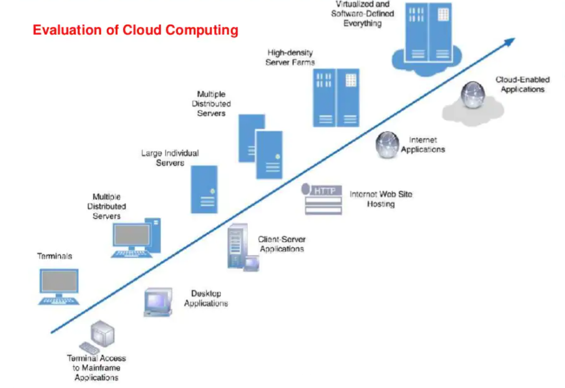

Slide 27
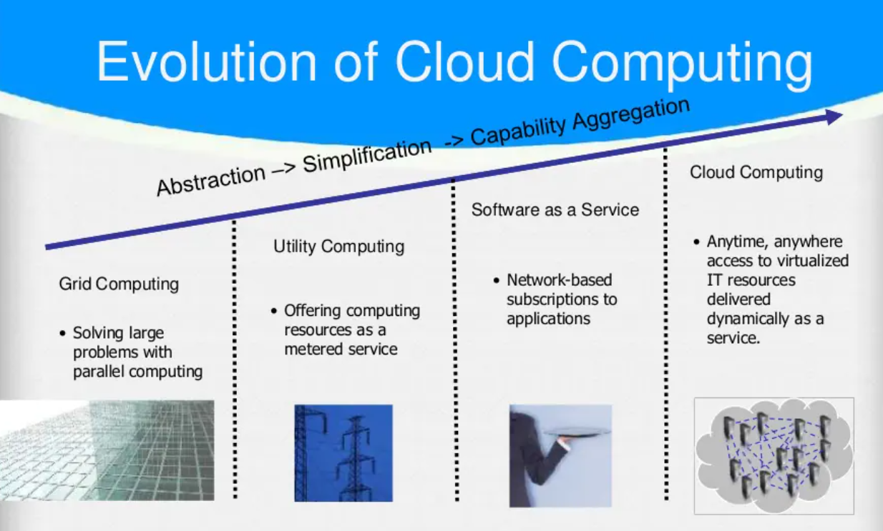

Slide 28
Cloud & Distributed
Cloud Computing | Distributed Computing
Cloud computing refers to providing on demand IT resources /services like server, storeage ,database , networking etc over internet | Distributed computing refers to solve a problem over distributed autonomous computers & they communicate between them over a network
It’s a computing technique that delivers hosted services over the internet to its users/customers | It’s a computing service which allows to multiple computers to communicate and work to solve a single problem
The goal of cloud computing is tp provide on demand computing services over internet on pay per use model

Slide 29
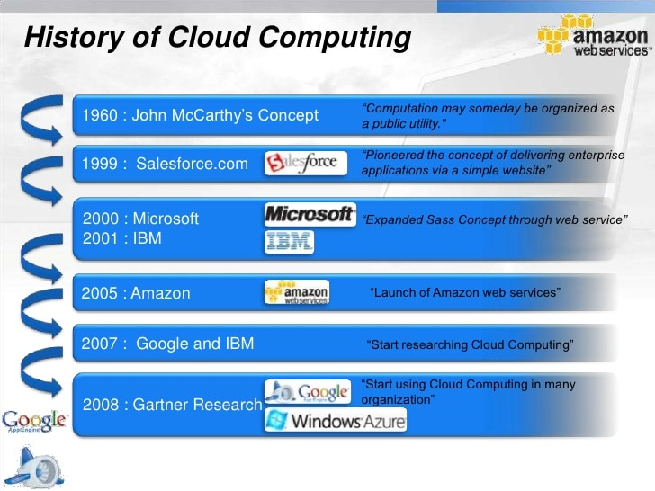

Slide 30
What is Cloud Computing?
Cloud computing is the delivery of computing services—including servers, storage, databases, networking, software, analytics, and intelligence—over the Internet (“the cloud”) to offer faster innovation, flexible resources, and economies of scale.
Cloud computing is a general term for the delivery of hosted computing services and IT resources over the internet with pay-as-you-go pricing.

Slide 31
How does cloud computing work?
Cloud computing lets client devices access rented computing resources, such as data, analytics and cloud applications over the internet.
It relies on a network of remote data centers, servers and storage systems that are owned and operated by cloud service providers.

Slide 32
Following steps are involved in cloud computing:
An internet network connection links the front end -- the accessing client device, browser, network and cloud software applications -- with the back end, which consists of databases, servers, operating systems and computers.
The back end functions as a repository, storing data accessed by the front end.
A central server manages communications between the front and back ends. It relies on protocols to facilitate the exchange of data. The central server uses both software and middleware to manage connectivity between different client devices and cloud servers.
Typically, there's a dedicated server for each application or workload.

Slide 33
Cloud computing relies heavily on virtualization and automation technologies. Virtualization lets IT organizations create virtual instances of servers, storage and other resources that let multiple VMs or cloud environments run on a single physical server using software known as a hypervisor.
This simplifies the abstraction and provisioning of cloud resources into logical entities, letting users easily request and use these resources. Automation and accompanying orchestration capabilities provide users with a high degree of self-service to provision resources, connect services and deploy workloads without direct intervention from the cloud provider's IT staff.

Slide 34
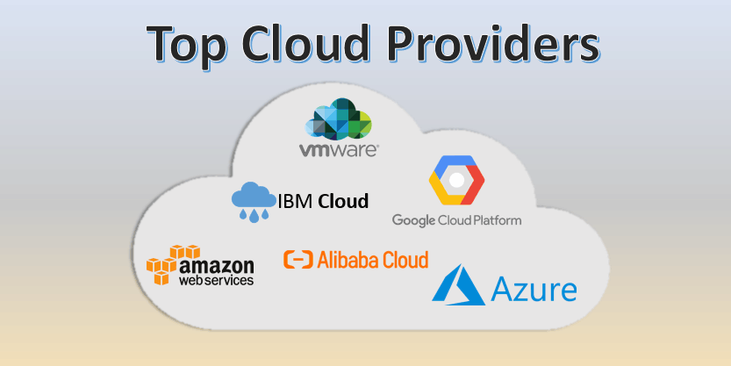

Slide 35
Comparison with traditional computing architecture (client/server)
Cloud Computing | Traditional Computing
It refers to delivery of different services such as data and programs through internet on different servers. | It refers to delivery of different services on local server.
It takes place on third-party servers that is hosted by third-party hosting companies. | It takes place on physical hard drives and website severs.
It is ability to access data anywhere at any time by user. | User can access data only on system in which data is stored.
It is more cost effective as compared to tradition computing | It is less cost effective as compared to cloud computing because one has to buy expensive equipment’s to operate and maintain server.

Slide 36
Cloud Computing | Traditional Computing
It is more user-friendly as compared to traditional computing because user can have access to data anytime anywhere using internet. | It is less user-friendly as compared to cloud
It requires fast, reliable and stable internet connection to access information anywhere at any time. | It does not require any internet connection to access data or information.
It provides more storage space and servers as well as more computing power so that applications and software run must faster and effectively. | It provides less storage as compared to cloud computing.
Cloud service is served by provider’s support team. | It requires own team to maintain and monitor system that will need a lot of time and efforts.
Software is offered as an on-demand service (SaaS) that can be accessed through subscription service. | Software in purchased individually for every user and requires to be updated periodically.

Slide 37
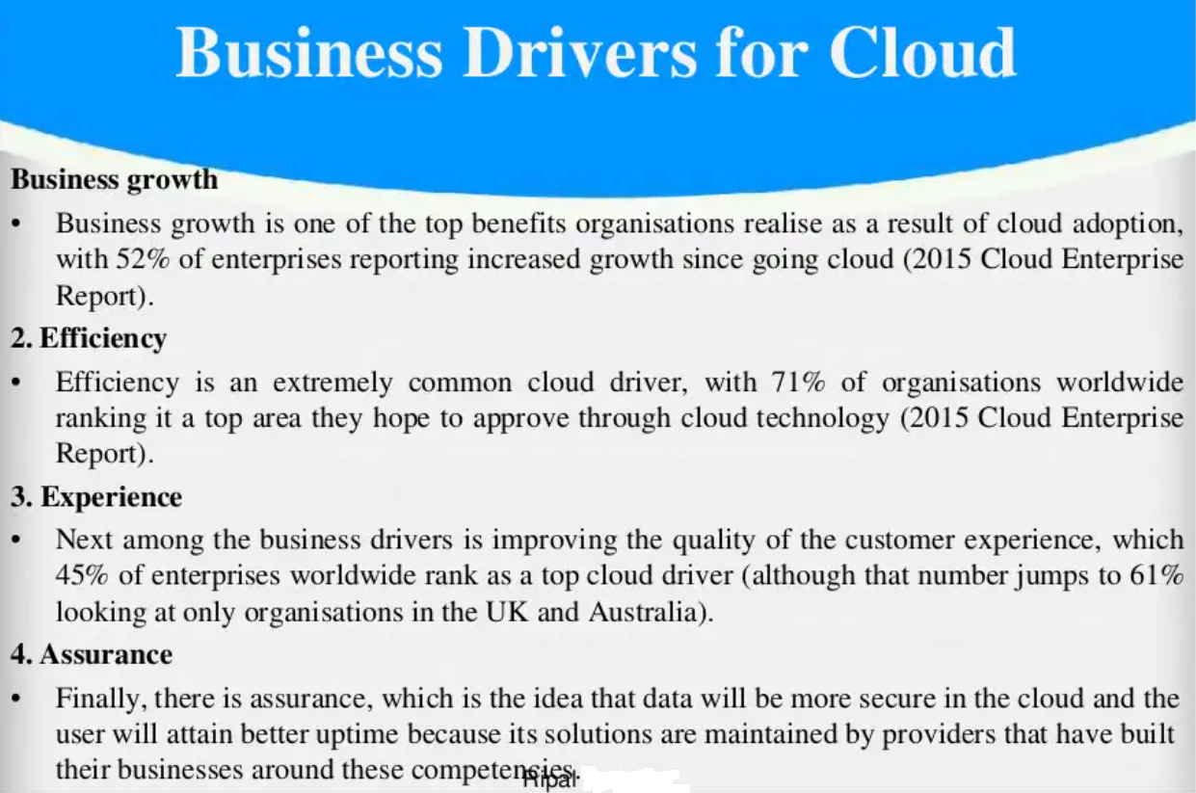

Slide 38
Business Drivers for Cloud
Capacity Planning
Level of Demand
Cost of Production
Availability of Funds
Cost Reduction
Organizational Agility
Role of Open Standards

